Slide 1


Customer Churn Prediction for Bank
Author: Angel Joy

Slide 2
Data Problem
The bank aims to reduce customer churn, improve service delivery, and enhance customer satisfaction.
Key Objectives:
Analyze customer churn patterns
Suggest recommendations

Slide 3
Data Snapshot
Total number of customers : 10000
Countries analyzed : 3
Data Cleaning and Preprocessing
Checked duplicates
Checked missing values
Replaced special characters

Slide 4
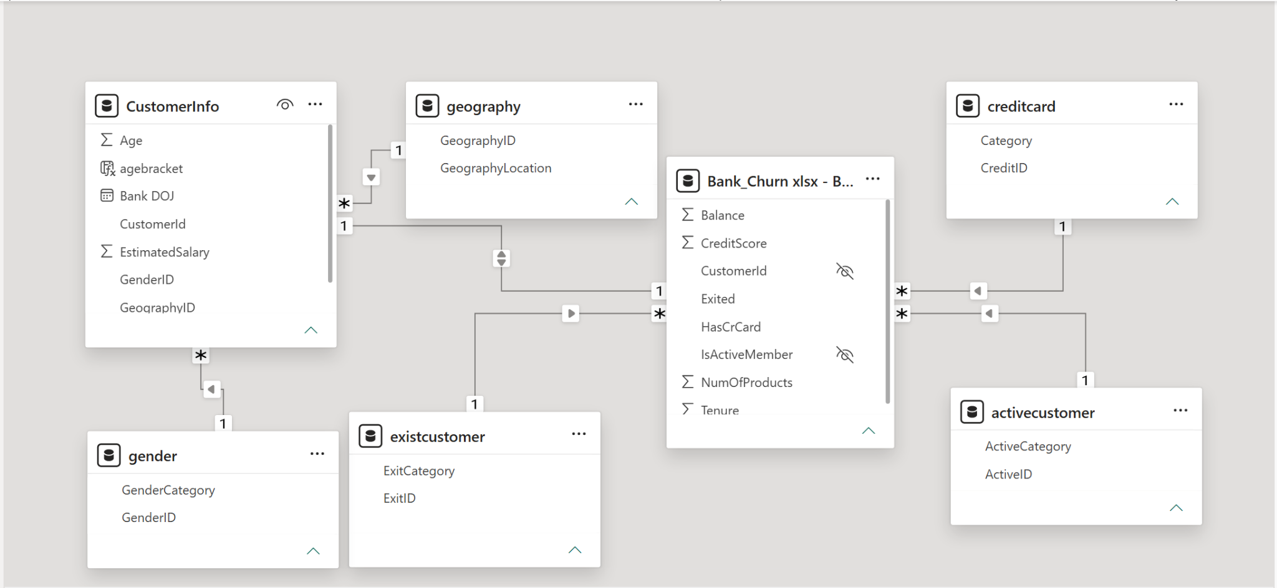
Data Schema

Slide 5
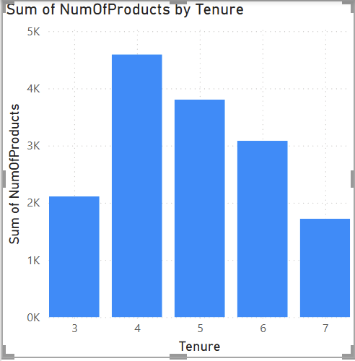
Customer Behavior Analysis
Long term customers are not spending much compared to the new customers
Long term customers might not be aware of the new services due to the lack of campaign reach
Customers are purchasing product once they feel trustworthy or comfortable with the bank

Slide 6
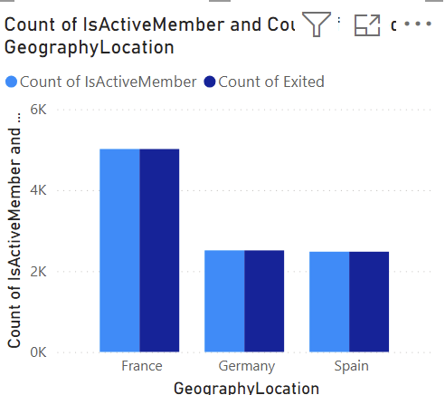
Geographic Market Trends
Active members and exited members are equal in all countries.
Population, employment factors can affect the active accounts and churn rates

Slide 7
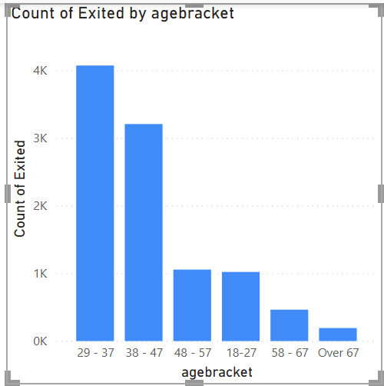
Risk Management Assessment
Exit rates are high in 29-47 age brackets
These groups might be married people with kids

Slide 8
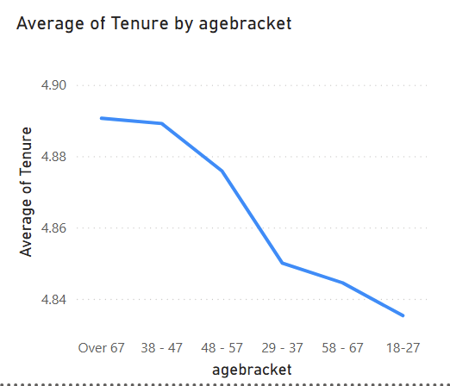
Customer Tenure Value Forecast
Tenure value is high for the age groups 38-47 and 48-57

Slide 9
Marketing Campaign Effectiveness
Customer Engagement data - sudden increase in the engagement might be impact of marketing campaign
Purchase history - Change in the purchasing behaviour
Marketing data - Required to analyse the impact

Slide 10
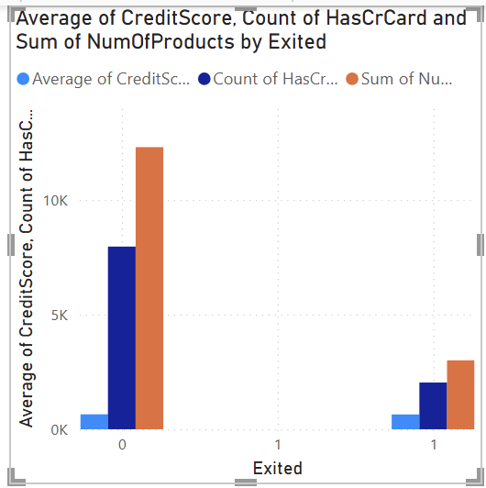
Customer Exit Reasons Exploration
Credit score have no much influence on exit customers behavior
Exit Customers doesn’t prefer credit card nor purchase much products
Age group of 29-37 are more intended to exit
France has shown high exit rate

Slide 11
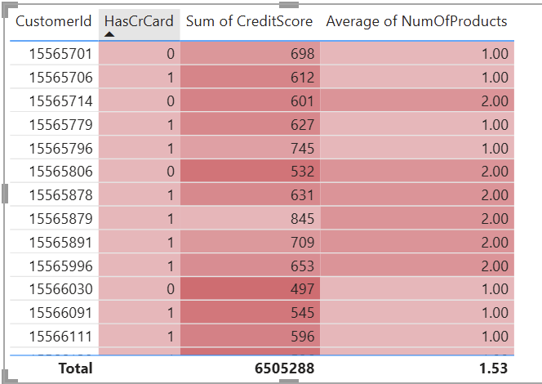
Customer at Risk
Dark red denotes risk
Light red denotes safe

Slide 12

Customer Churn Pattern
Credit score have no much influence on exit customers behavior
Exit Customers doesn’t prefer credit card nor purchase much products
Age group of 29-37 are more intended to exit
Country France has shown high exit rate

Slide 13
Strategic Recommendations
Build Trust & Engage
Long term customers are loyal customers, marketing team has to do campaign to re-introduce the services to them
Customer service calls has to be done once in 3 months
Engage with the customers to build trust and make them feel confident with the banking

Slide 14
Strategic Recommendations
Incorporate services apt for married couples and their kids
Exit rates are high in 29-47 age brackets. This group might be married couples with kids

Slide 15
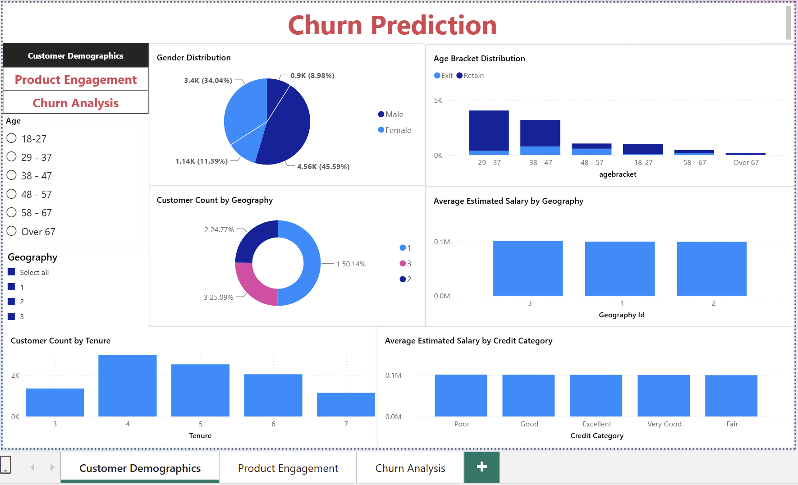
Dashboard and Visualizations

Slide 16
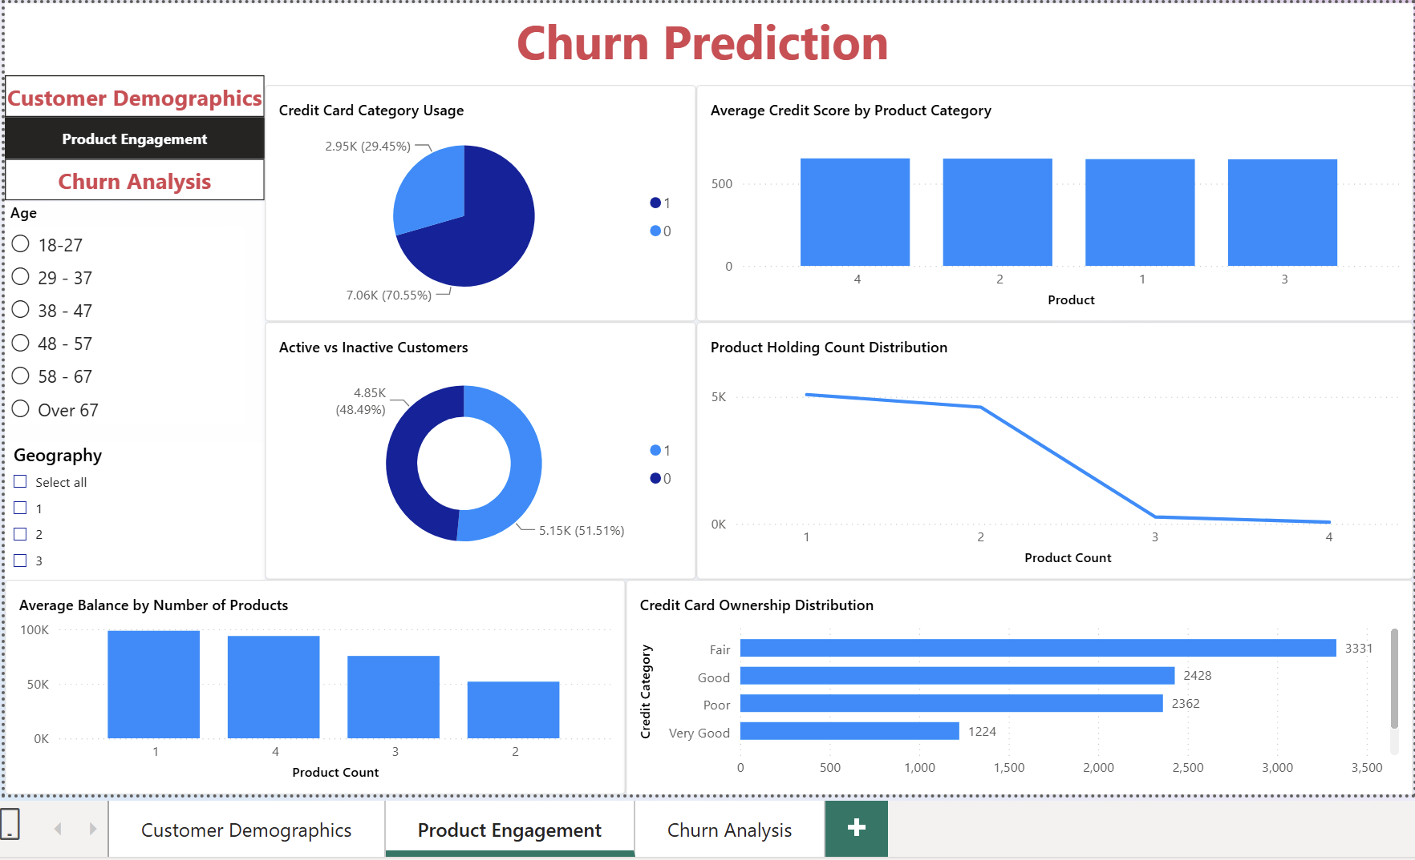
Dashboard and Visualizations

Slide 17
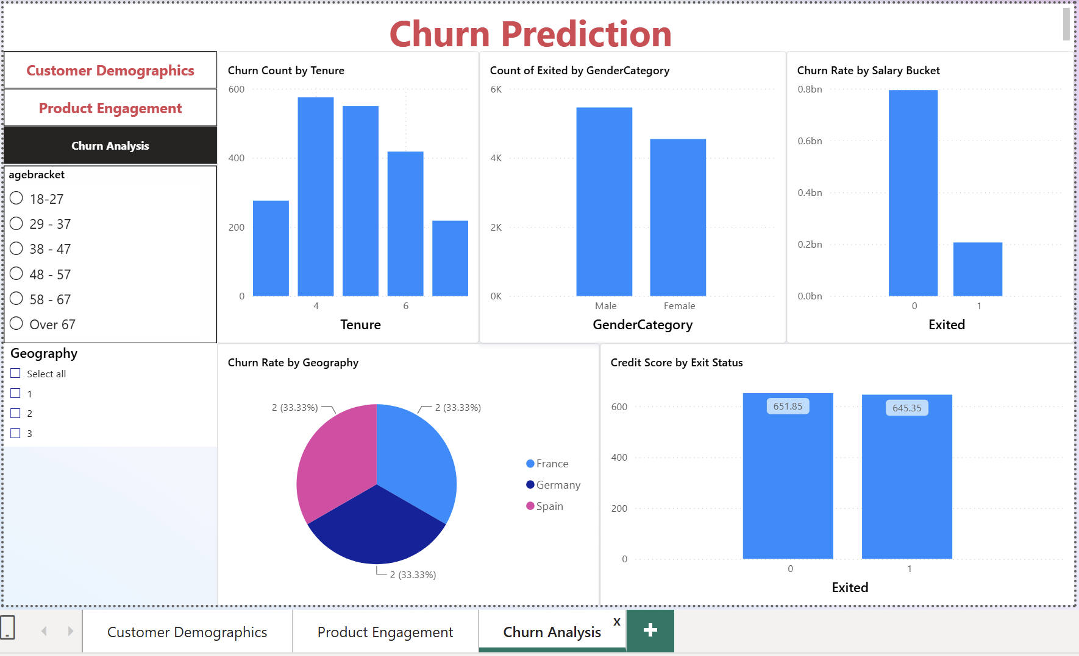
Dashboard and Visualizations

Slide 18

Conclusion
Identified churn pattern
Found the factors that affect the customer exit
Analyzed the behaviour of the different age groups
Build trust and engagement through campaigns
Incorporate services apt for young married couples and for kids

